Slide 1

Impressive heights reached in transactional videogames – but battle for consumer retention must begin.
Kantar
May 2021
Sam Causley

Slide 2


Kantar Worldpanel – Who we are
Our panel of 15,000 GB Entertainment individuals provides us with a robust picture of the Entertainment market, how and why your consumers behave the way they do and the insights you need in order to win.
The following slides focus on videogame software for consoles and PC (pre-owned and streaming excluded).

Slide 3
Lockdown manifested in staggering growth for transactional games and it’s only the most recent 52 w/e period where we see that growth begin to slow.
Contribution to Growth | Physical & Digital Games | Rolling 52 w/e
Source: Kantar Worldpanel | Transactional Videogames | 52 we data to 4th April 2021

Slide 4
With close to one 1 in 5 of the GB population having purchased a videogame in the last year, retention as opposed to penetration growth will be key in the short term.
Penetration (%) of Transactional Videogame formats over time
Source: Kantar Worldpanel | Transactional Videogames | 52 we data to 4th April 2021

Slide 5
Growth of engagement from young families leaves us in a unique position to continue to attract engagement from a group who have historically very low engagement in videogames.
Total Transactional Games | YOY Spend Growth by Group (£%) | 52 w/e 4th April 2021 vs LY
Source: Kantar Worldpanel | Transactional Videogames | 52 we data to 4th April 2021
Notes:
Use colour to highlight key value.
Any colour from the ppt theme colours can be used.
Use grey/dark grey as a contrast colour.

Slide 6

Videogame buyers are now well versed in digital transactions. While the majority of spend still goes to physical games, almost 70% of transactions are digital games.
(%) by Format | This Year vs Last Year
52 w/e 05 Apr 20
52 w/e 05 Apr 20
52 w/e 04 Apr 21
52 w/e 04 Apr 21
Spend %
Volume %
Spend %
Volume %
Source: Kantar Worldpanel | Transactional Videogames | 52 we data to 4th April 2021

Slide 7
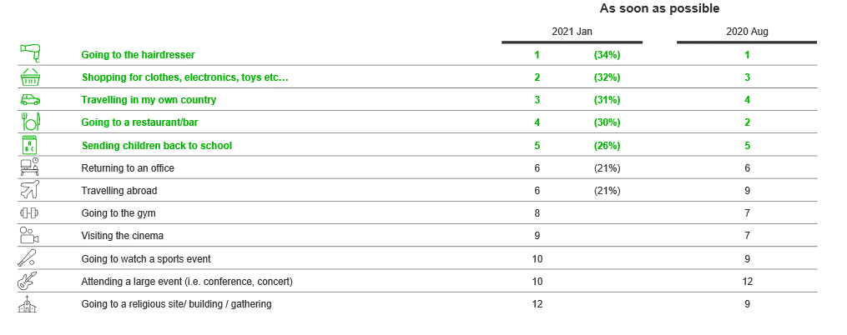
With lockdown loosening, the plethora of alternate activities potentially available to us in H2, means the second half of the year must be a focus on retention of gamers as opposed to further growth.
What do you plan to do when restrictions are loosened?

Slide 8

Keeping children occupied at home was a key source of growth over the last year but so was ‘social gaming in the home’. The loosening of lockdown only facilitates more opportunities for social gaming in the home as friends and family are re-united.
Total Games | YOY Spend Growth by Reason for Purchase | 52 w/e 4th April 2021 vs LY
Total
Games
Single
Player
Multiplayer
Online
Social Gaming
in the Home
Children to
Play at Home
Gift
Source: Kantar Worldpanel | Transactional Videogames | 52 we data to 4th April 2021
Notes:
Use colour to highlight key value.
Any colour from the ppt theme colours can be used.
Use grey/dark grey as a contrast colour.

Slide 9
Executive Summary
The Transactional Videogame Market benefited from staggering growth during lockdown - but the battle for consumer retention must begin.
It’s only the most recent 52 w/e period that we’ve seen growth begin to slow but the ‘re-opening’ of the world us means we now face a bigger struggle to retain gamer’s attention.
Lockdown introduced gaming to demographics who typically show low engagement.
Young Families increased their spend on videogames by over 130% over the last year. Key to retaining them will be understanding which consoles, occasions, genre’s and titles are drawing them in.
Social Gaming in the home grew it’s importance in lockdown and could be the perfect occasion to lead us out.
The loosening of lockdown only facilitates more opportunities for social gaming in the home as friends and family are re-united. Make sure a shared gaming occasion is part of the consideration when we finally mingle in each others households again.

Slide 10
Thank you
For further information please contact:
Sam Causley
Tel.: +44 (0)7787 154688
Sam.Causley@kantar.com

